Slide 1


Slide 2

PURSUE GENEROSITY
What is your attitude toward GIVING, TITHING and the Church?

Slide 3


Slide 4
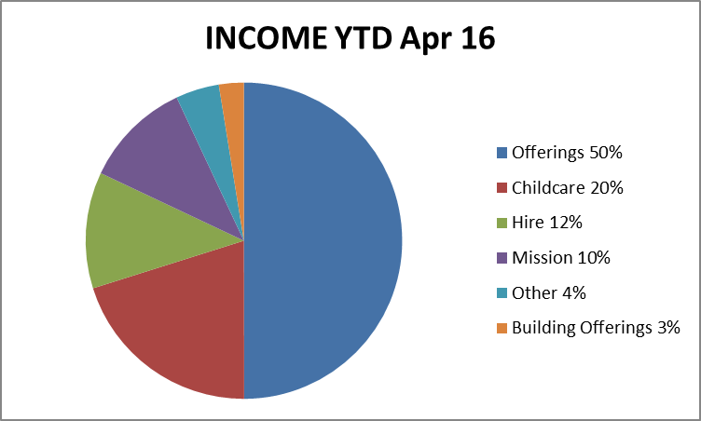
PURSUE GENEROSITY

Slide 5
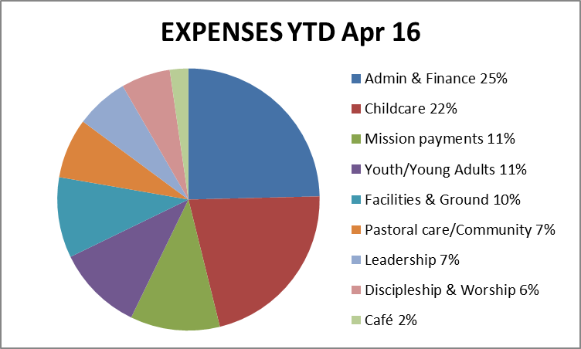
PURSUE GENEROSITY

Slide 6
CHEERFULLY
2 Corinthians 9:6 Remember this: Whoever sows sparingly will also reap sparingly, and whoever sows generously will also reap generously. 7 Each of you should give what you have decided in your heart to give, not reluctantly or under compulsion, for God loves a cheerful giver.

Slide 7
REGULARLY & INTENTIONALLY
1 Corinthians 16:1 Now about the collection for the Lord’s people: Do what I told the Galatian churches to do. 2 On the first day of every week, each one of you should set aside a sum of money in keeping with your income, saving it up, so that when I come no collections will have to be made.

Slide 8
SACRIFICIALLY
Mark 12:41 Jesus sat down opposite the place where the offerings were put and watched the crowd putting their money into the temple treasury. Many rich people threw in large amounts. 42 But a poor widow came and put in two very small copper coins, worth only a few cents.
43 Calling his disciples to him, Jesus said, “Truly I tell you, this poor widow has put more into the treasury than all the others. 44 They all gave out of their wealth; but she, out of her poverty, put in everything—all she had to live on.”

Slide 9
SO WHAT?
Thank you!
Start some where?
Get control of your finances (text 0417 071 026 if you are interested in doing CAPS NOW)
Are you discipling your children in this area?
What legacy will you leave your family and the next generation of Kingdom Builders?

